Slide 1
Research Paper | Year of Publish | Writers | Advantage | Limitation | Methodology
Challenges for Toxic Comment Classification: An In-Depth Error Analysis | 2018 | Betty van Aken , Julian Risch , Ralf Krestel , and Alexander Loser | word and character ngrams learned by our Logistic Regression classifier produce strongly uncorrelated predictions that can be combined for increasing accuracy. | a large source of errors is the lack of consistent quality of labels. | Shallow classification and neural networks, Multi-class approaches, Ensemble learning
Convolutional Neural Networks for Toxic Comment Classification | 2018 | Spiros V. Georgakopoulos, Sotiris K. Tasoulis, Aristidis G. Vrahatis, Vassilis P. Plagianakos | CNN can outperform well established methodologies providing enough evidence that their use is appropriate for toxic comment classification | A main limitation of these models is that they are not as reliable as it should and that usually the degree of toxicity is not determined | CNN for Text Classification
Imbalanced Toxic Comments Classification Using Data Augmentation and Deep Learning | 2018 | Mai Ibrahim, Marwan Torki ,Nagwa El-Makky | The evaluation results show that the proposed ensemble approach provides the highest accuracy among all considered algorithms. | Accuracy and prediction does not match well | The proposed solution is an ensemble of three models: convolutional neural network (CNN), bidirectional long short-term memory (LSTM) and bidirectional gated recurrent units (GRU).
Overlapping Toxic Sentiment Classification Using Deep Neural Architectures | 2018 | Hafiz Hassaan Saeed, Khurram Shahzad, Faisal Kamiran | proposed classification framework does not require any laborious text pre-processing and is capable of handling text pre-processing (e.g. stop word removal, feature engineering, etc.) intrinsically. | Cannot handle huge amount of data | Deep Neural Network (DNN) architectures to classify the overlapping sentiments with high accuracy.

Slide 2
Implementing an Encryption method for File management System
17BCB0065 PRATEEK SRIVASTAVA

Slide 3
Objectives
Generic design for cryptographic file systems and its realization in a distributed storage-area network (SAN) file system.
Implement a file encryption technique using AES for the windows platform.

Slide 4
Literature Survey
Research Paper | Year of Publish | Writers | Advantage | Limitation | Methodology
Security Systems: A concept through Encrypting File System | March 2013 | Shruti Jain, Chintal Kumar Patel | Makes crucial distinction between the kernel and user- space from a security perspective. | Realization in a distributed Storage-area network (SAN) file system. | Advance key management scheme to provide a high grade of security while remaining transparency and usability.
CifrarFS – Encrypted File System Using FUSE | October 2009 | Anagha Kulkarni, Vandana Inamdar | It gives an extra security to the user against offline attacks | Does not handle integrity of encrypted files in a more efficient way | CifrarFS’, an encrypted file system using ‘File system in USEr space (FUSE)’ maintains all the files in a specific directory in an encrypted form and decrypts them on demand.

Slide 5
Research Paper | Year of Publish | Writers | Advantage | Limitation | Methodology
Efficient methodology for implementation of Encrypted File System in User Space | 2009 | Dr. Shishir Kumar, U.S. Rawat, Sameer Kumar Jasra, Akshay Kumar Jain | Implementing EFS in user space makes it portable & flexible; Kernel size will also not increase resulting in more reliable & efficient Operating System | It has shortcomings of a user-level NFS server based implementation | implementation of EFS in user space using faster cryptographic algorithms on UNIX Operating system
Cryptfs: A Stackable Vnode Level Encryption File System | 2014 | Erez Zadok, Ion Badulescu | -Cryptfs performs better than user-level or NFS based file servers such as CFS -It is 2 to 37 times faster on micro-benchmarks such as read and write | -properly handling them requires some manipulation of lower level file systems -it forced us to maintain lots of state | It is designed as a stackable Vnode layer loadable kernel module. Cryptfs operates by “encapsulating” a client file system with a layer of encryption transparent to the user.

Slide 6
Research paper | Year of publish | Authors | Advanatges | disadvantages | Methodology
A survey of File encryption and decryption system based on RSA algorithm | April 2015 | Suli Wang, Ganlai Liu | -can be more convenient to communicate and manage -easily communicate data and text files under the environment which demand a high security | -RSA algorithm can be very slow in cases where large data needs to be encrypted by the same computer | RSA public key encryption algorithm

Slide 7
Proposed Method
Overview:
Security and privacy are hot topics at the moment. This is an opportunity for us to take an introspective look into the way we approach security. It is all a matter of compromise - convenience versus total lock down.
The app we are going to build will allow people to choose files from their computers and encrypt them client-side with a pass phrase. No server-side code will be necessary, and no information will be transferred between client and server. To make this possible we will use the HTML5 FileReader API, and a JavaScript encryption library - CryptoJS.

Slide 8
Proposed Method
System Architecture
EFS works by encrypting a file with a bulk symmetric key
uses a symmetric encryption algorithm
The FEK (the symmetric key that is used to encrypt the file) is then encrypted with a public key that is associated with the user who encrypted the file
To decrypt the file, the EFS component driver uses the private key that matches the EFS digital certificate (used to encrypt the file) to decrypt the symmetric key that is stored in the $EFS stream.

Slide 9
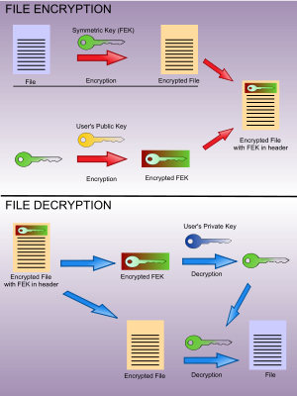


Slide 10
Functional Architechure:
AES is a symmetric key encryption algorithm that essentially lets the key to be used for encryption and decryption of data. A computer program takes clear text and processes it through an encryption key and returns ciphertext.
If data needs to be decrypted, the program processes it again with the same key and reproduces the clear text. It requires less computational resources that means lower performance impact.
Key Parameters
keyalg: algorithm used to create the key (AES)
keysize: size of the key (128, 192, 256, etc)
alias: alias given to the newly created key
keypass: password protecting the use of the key

Slide 11
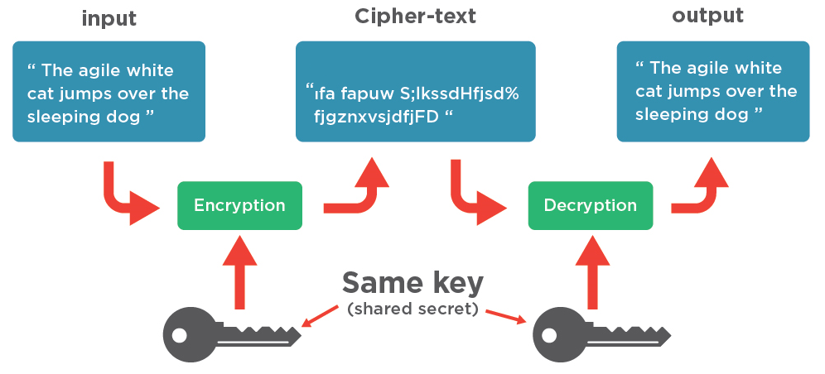

Slide 12
Modular Design:
1)Text encrpyption module

Slide 13
2)Text decryption module

Slide 14
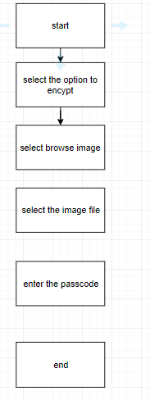
3)Image Encryption module

Slide 15
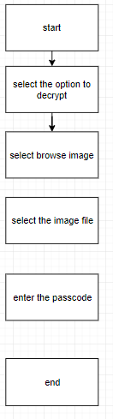
4)Image decryption module

Slide 16
Implementation Details:
The app we are going to build will allow people to choose files from their computers and encrypt them client-side with a pass phrase. No information will be transferred between client and server. To make this possible we will use the HTML5 FileReader API, and a JavaScript encryption library - CryptoJS.

Slide 17
The HTML
The markup of the app consists of a regular HTML5 document and a few divs that separate the app into several individual screens. You will see how these interact in the JavaScript and CSS sections of the tutorial.
Only one of the step divs is visible at a time. Depending on the choice of the user - to encrypt or decrypt - a class name is set on the body element. With CSS, this class name hides the elements with either the “if-encrypt” or “if-decrypt” classes. This simple gating allows us to write cleaner JavaScript that is minimally involved with the UI.

Slide 18
The CSS
It is a highly effective HTML tool that provides easy control over layout and presentation of website pages by separating content from design.

Slide 19
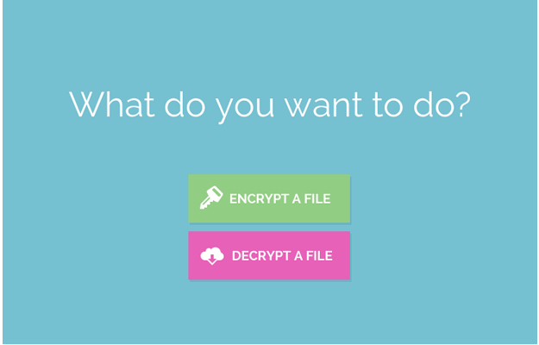

Slide 20
The JavaScript Code
We are going to use the HTML5 and the CryptoJS library together. The FileReader object lets us read the contents of local files using JavaScript, but only of files that have been selected explicitly by the user through the file input's browse dialog.

Slide 21
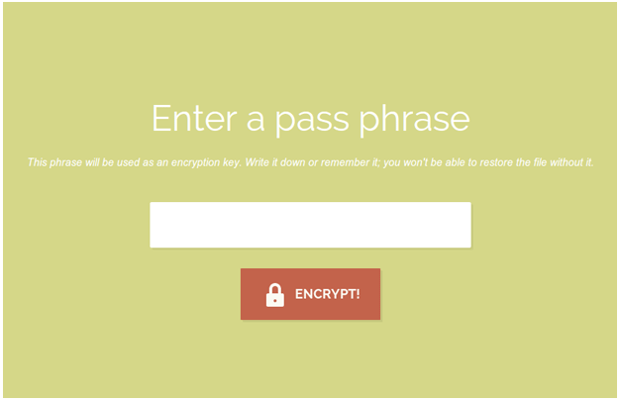

Slide 22
Issues
Following items cannot be encrypted:
Compressed files
System files
System directories
Root directories
Transactions
Anyone who can gain Administrators access can overwrite, override or change the Data Recovery Agent configuration. This is a very serious issue, since an attacker can for example hack the Administrator account (using third-party tools), set whatever DRA certificate they want as the Data Recovery Agent and wait. This is sometimes referred to as a two-stage attack, which is a significantly different scenario than the risk due to a lost or stolen PC, but which highlights the risk due to malicious insiders.

Slide 23
Applications
Generally this concept is used in offices which requires highly secured files like Banks, Defense, Medical History documentations etc.
Also prevents the attack if the attacker physically approaches the file hence this system is also used in publicly accessible computers like on Railways stations.

Slide 24
Novelty
At a instant only one file can be encrypted and transmitted. As a future work multiple file encryption and decryption can be possible.
We will try to encrypt audio and image files and improve encryption time and decryption time.

Slide 25
References
[1] Shruti Jain, Chintal kumar Patel, “Security Systems: A concept through encrypting file system” international journal of advanced research in computer science, March 2013
[2] Anagha Kulkarni, Vandana Inamdar, “Cifrarfs – Encrypted File System using FUSE ”, international journal of computer science and security , (IJCSS) volume (3) , October 2009
[3] Dr. Shishir Kumar, U.S. Rawat, Sameer kumar Jasra, Akshay kumar Jain, “Efficient methodology for implementation of Encrypted File System in user space” (IJCSIS) international journal of computer science and information security, vol. 3, January 2009.
[4] Cryptfs: A Stackable Vnode Level Encryption File System Erez Zadok, Ion Badulescu, and Alex Shender Computer Science Department, Columbia University {ezk,ion,alex}@cs.columbia.edu, 2014
[5] File encryption and decryption system based on RSA algorithm Suli Wang Ganlai Liu School of Information Engineering Support Center Jingdezhen Ceramic Institute Jingdezhen Telecom Jingdezhen, Jiangxi Province, China Jingdezhen, Jiangxi Province, 2015

